Slide 1
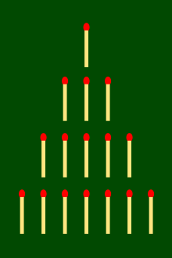
(Modified) Nim Game Beater in Python
Suguru Chhaya
Github for this project:
https://github.com/SuguruChhaya/nim-game

Slide 2

Python skills you will need:
Very basic understanding of using methods in classes.
Using exceptions
General use of strings(f-strings, managing input)

Slide 3
What is the Nim Game?
The Game of Nim is a mathematical game said to be originated in China.
The normal game is between two players and played with three heaps of any number of objects. Each player removes any number of objects from one of the heaps.
The objective is to make the other person to remove the last number!!

Slide 4

Example game play:
One pile of 3 matches, another pile of 2 matches
A
B
A loses!!

Slide 5
My modifications
Base idea of the modified version: A and B are counting until 30. They can count up to 3 numbers at a time. Whoever counts 30 loses.
More generic way:
A and B are counting until X. (user input)
They can count up to Y numbers at a time.
Whoever counts X loses.

Slide 6
Initial Approach/Strategy
For A to win the game when max (counting until): 30, A has to count 29 to win the game.
To make this happen, A has to take control of the game so A can always count 29.
When the current number is N, notice that no matter what Player B counts up to (N+1, N+2, N+3), Player A can bring the current number to N+4.
E.g. When N = 25
Player B: 26 (N+1) Player A: 27, 28, 29 (N+4)
Player B: 26, 27 (N+2) Player A: 28, 29 (N+4)
Player B: 26, 27, 28 (N+3) Player A: 29 (N+4)

Slide 7
(continued)
If we can take control by always being able to land at N+4, there must be a set of must a set of numbers we should land on to win!!
For the previous example, how do we find the sets?
Do we know which number the list will start at?:
Do we know which number the list should end at?:
We start by subtracting 4 from 29 and we end up with this list:
[1, 5, 9, 13, 17, 21, 25, 29] 3
NO
YES, 29 (30-1)!!

Slide 8
LET’S START CODING!!

Slide 9
Step 1: Initial inputs
Inputs:
An integer reaching_number (counting up to...)
A max increment (can count up to…)
Whether the player or the computer goes first
We can use exception handling to check whether the inputs are valid!! We can use a while loop to continue asking the user for inputs while the inputs aren’t valid!!

Slide 10
Step 2. Creating __init__() and gotoplayerturn() methods in the MainGame class.
Player: Types in the input.
Computer: Automatically chooses the best move.
Need separate methods the player and computer!! Program must recognize whether the computer is going first or the player is going first.

Slide 11
Step 3: Creating the self.no_input_character() method
Using the self.win_number_list, the computer must make a move which lands on one of the numbers in the list.
If the player is using the winning strategy, there is nothing the computer can do. In this case, the computer can just pick a random number between 1 and the max_increment. But the computer will check whether the player is still following the winning strategy or not.
Should lead to the next method (self.input_character())
Must check whether self.total >= self.reaching_number

Slide 12
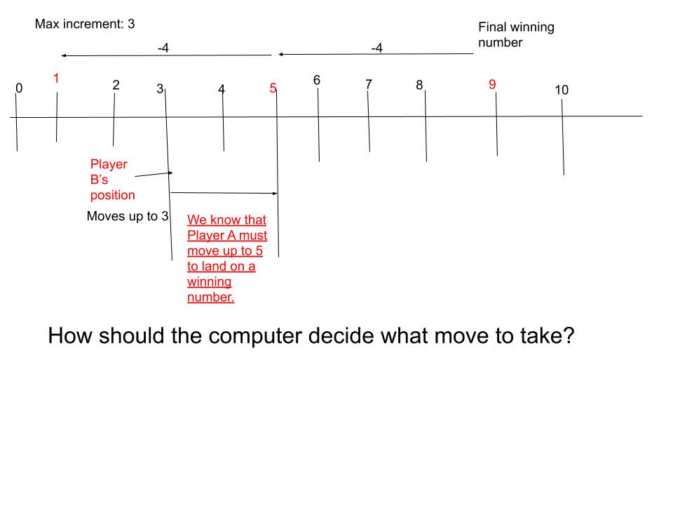
Example scenario for generating best number:

Slide 13
To select which number to land on (our new self.total), the number which we are landing must be bigger than the current total value.
E.g. Can go up to 5 but cannot go back to 1
Now we have 2 numbers we can land on: 5 and 9 (because 1 eliminated due to previous condition). But we can only move to 9. How can we eliminate 9?
The difference between the number which we are landing and the current self.total must be less than the max_increment.
(The reason we jump to 9 is because 9 - 3 = 6, which is larger than the max_increment 3. Basically we cannot move by 6 because max movement is 3.

Slide 14
Last Step: Creating a self.input_character() method
Ask for an input from the user.
While the input is smaller or is invalid, use a while loop and exception handling to keep on asking the user for input.
Leads to self.no_input_character.
Must check whether self.total >= self.reaching_number

Slide 15
Demos:
E.g.1: Reaching number 30, Max increment 3
Win_number_list = [29, 25, 21, 17, 13, 9, 5, 1] = [1, 5, 9, 13, 17, 21, 25, 29]
E.g. 2: Reaching number 40, Max increment 4
Win_number_list = [39, 34, 29, 24, 19, 14, 9, 4] = [4, 9, 14, 19, 24, 29, 34, 39]

Slide 16


Thank you so much for watching!!
Blogs and more content:
suguruchhaya.wixsite.com/mysite
suguru_chhaya

